Slide 1
Long Term Care Insurance
Educational Overview and Plan-at-a-Glance

Slide 2
What is Long Term Care (LTC)?
Long term care is the assistance a person may need with the basic activities of daily living – eating, bathing, dressing, transferring, toileting, and continence. It can also include supervision needed to protect a person’s health and safety. The need for long term care may develop from things such as an accident, illness, stroke, advanced age or other chronic condition such as Alzheimer’s, dementia or Parkinson’s disease. Long term care consists mainly of personal care rather than medical care, which is typically covered by a health plan.

Slide 3
Long Term Care can be provided…

Slide 4
Long Term Care vs. Medical Insurance

Slide 5
Long Term Care vs. Medical Insurance (cont’d)

Slide 6
It’s important to plan ahead
Will you need long term care?
Your chances may be more likely than you think.
About 6 million Americans age 65⁺ require help with at least two activities of daily living for ninety days or more, or have a severe cognitive impairment.¹
¹ Health Affairs, Financing Long-Term Services and Supports: Options Reflect Trade-Offs For Older Americans and Federal Spending, November 2015

Slide 7
Most people aren’t planning ahead
² LIMRA and Life Happens. 2017 Insurance Barometer Study. Windsor, CT.
³ Associated Press-NORC Center for Public Affairs Research. Long-Term Care in America: Expectations and Preferences for Care and Caregiving. Chicago, IL. 2016

Slide 8
Planning for long term care might be easier than you think
You protect your home, your car and your health. But what about your savings and retirement? Many of us strive for financial security and plan for a comfortable retirement. But what if you could no longer take care of yourself?
Relying on a relative or a friend for caregiving is certainly an option — especially for short periods of time. But if you needed personal care for weeks, months, or even years, it could be expensive for you and your family.

Slide 9
Planning for long term care might be easier than you think (cont’d)
Your financial plan was likely designed to help you save for years of retirement.
To help protect your savings, consider how you might pay for long term care services should the need arise for you or your spouse/partner.

Slide 10
How much could long term care cost?

Slide 11
Paying for Long Term Care
LTC services are not typically covered by medical insurance plans.
Medicare may help pay for limited LTC services under certain circumstances, but often doesn’t meet long term care needs. Medicaid has specific rules and income requirements that can require recipients to spend down their savings and assets to meet state poverty guidelines.
Some people rely on care from family and friends, but it can impact the financial, physical and emotional health of entire families.

Slide 12
How much coverage is enough? It depends.
These factors can help you determine the right of coverage for your unique situation.

Slide 13
How much coverage is enough? It depends. (cont’d)
These factors can help you determine the right of coverage for your unique situation.

Slide 14
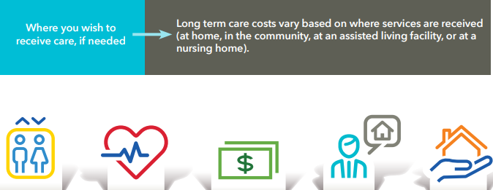
How much coverage is enough? It depends. (cont’d)
These factors can help you determine the right of coverage for your unique situation.

Slide 15
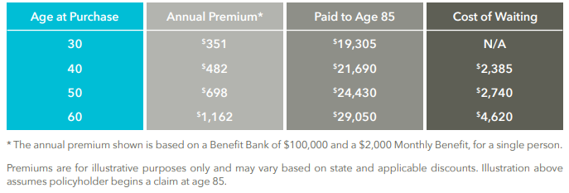
When should you buy LTC insurance?
Waiting to purchase a long term care insurance policy could actually increase the total amount of premium you would pay by thousands of dollars.

Slide 16
About LifeSecure
LifeSecure Insurance Company was founded in 2006 as a Michigan-based insurance company, which quickly expanded to a national presence. LifeSecure is dedicated to providing a different kind of insurance experience to help create a better future for our customers.
We are proud to offer a long term care insurance product that continues our tradition of simplicity and flexibility. Our straightforward Benefit Bank design and optional benefits help individuals and families find the right amount of coverage to meet their own personal needs!

Slide 17
Plan-at-a-Glance Long Term Care Insurance

Slide 18
Standard Features (cont’d)
Monthly Benefit Payout Structure:
When you become eligible for benefits, you can choose between the payout options below (in accordance with your Plan of Care):
OPTION 1: Receive reimbursement for qualified long term care services, up to your Monthly Benefit for Covered Expenses. Covered expenses include care at home through a home care agency or independent provider, in an assisted living facility, in an adult day care center, or in a nursing home. Hospice care is also covered.
OPTION 2: Elect to receive a cash payout, equal to your Cash Alternative Monthly Benefit amount. The cash benefits can be used to pay an informal caregiver, such as a family member or friend — or used for other purposes unique to your care situation. Note: The choice between the two options can be made on a monthly basis. Any un-used Monthly Benefit dollars will remain in your Benefit Bank and extend the life of your policy.
Note: The choice between the two options can be made on a monthly basis. Any un-used Monthly Benefit dollars will remain in your Benefit Bank and extend the life of your policy.

Slide 19
Standard Features (cont’d)
Home Modification and Supplemental Products Benefit
This benefit provides coverage for services and products that are required for you to live more securely and independently at home (in accordance with your Plan of Care). These expenses are reimbursable up to 1X your Monthly Benefit for Covered Expenses over the life of your policy. Payouts made under this benefit will reduce your Benefit Bank amount.
Examples of services and products that are eligible for reimbursement include:
Home Modifications
Assistive Devices or Technology
Durable Medical Equipment
The Home Modification and Supplemental Products Benefit can be received in addition to other reimbursable Covered Expenses or the Cash Alternative in a given month.

Slide 20
Benefit Eligibility
You are eligible for benefits if you have been certified as Chronically Ill within the last 12 months by a Licensed Health Care Practitioner. This means that you are unable to perform at least two Activities of Daily Living (bathing, dressing, toileting, transferring, continence and eating) for a period that is expected to last at least 90 days, or you require Substantial Supervision to protect your health and safety due to a Severe Cognitive Impairment.

Slide 21
Benefit Wait Period
90 Calendar Days (once you are verified as Chronically Ill), unless your condition is triggered suddenly by an Accidental Injury or Stroke, in which case the Benefit Wait Period will be completely waived (0 days).

Slide 22
Waiver of Premium
Your premiums are waived beginning on the first day you start receiving benefits. As long as you continue to receive benefits, additional premiums will not be required.

Slide 23
Spouse Discount
If you and your spouse/partner both apply for coverage at the same time, a 10% premium discount will apply to each policy.

Slide 24
Optional Benefit Riders
Compound Inflation Benefit (1%, 3% or 5%)
If you elect this optional benefit, we will automatically increase your current Monthly Benefit and your remaining Benefit Bank by 1%, 3% or 5% each year. The increase will be effective on each anniversary of your policy and rider, even while you are receiving benefits.
Nonforfeiture Benefit
If this rider is in force for at least three full years, and your policy then terminates due to non-payment of premium, this optional benefit allows you to retain a reduced paid-up amount of coverage. You will have a revised Benefit Bank equal to the greater of: (a) 100% of the sum of all premiums paid by you; or (b) one times your Monthly Benefit.

Slide 25
Policy Limitations and Exclusions
This Policy will not pay benefits for care, treatment, services or charges: for a loss that occurs while this Policy is not in force; or for alcoholism or drug addiction (except for an addiction to a prescribed medication administered on the advice of a Physician); or due to declared or undeclared war or act of war; or due to participation in a felony, riot or insurrection or involvement in an illegal occupation; or due to suicide, attempted suicide or intentionally self-inflicted injury; or that are reimbursable under Medicare, or would be so reimbursable but for the application of a deductible or coinsurance amount; or that are reimbursable or provided under a governmental program (except Medicaid), any state or federal workers’ compensation, employer’s liability or occupational disease law; or provided outside the United States, Canada or their territories or possessions; or for which no charge is made in the absence of insurance, except as provided under the Cash Alternative Monthly Benefit; or provided by an Immediate Family member (except as provided under the Cash Alternative Monthly Benefit), unless: he or she is a regular employee of an organization which is providing the care, treatment or service; he or she receives no compensation other than the normal compensation for employees in his or her job category; and the organization receives the payment for the care, treatment, service or charge.

Slide 26
YourLifeSecure.com
LifeSecure and the logo are trademarks of LifeSecure Insurance Company, New Hudson, MI. Our long term care insurance product is individually underwritten by LifeSecure Insurance Company and may require a medical exam. This item is for illustrative purposes only and is not a contract. It is intended only to provide a general overview of our product and services. Availability of benefits, amounts, options and discounts may vary by state. Only the insurance policy can give actual coverage amounts, terms, conditions, limitations and exclusions. Refer also to the Outline of Coverage. This policy is guaranteed renewable for life and is intended to be federally tax-qualified as defined by the Internal Revenue Code of 1986, §7702B(b). Applicants are required to provide medical information. Premiums may increase. There is a 67 day grace period for premium payments. This is an insurance solicitation. An agent may contact you.
Information in this presentation appears in the following LifeSecure long term care insurance advertising materials:
ICC17-LS-LTC-0307; LS-LTC-0307 ST; ICC17-LS-LTC-0300; LS-LTC-0300 ST
Policy Form Series: ICC17-LS-LTC-0006; LS-LTC-0006

